Slide 1
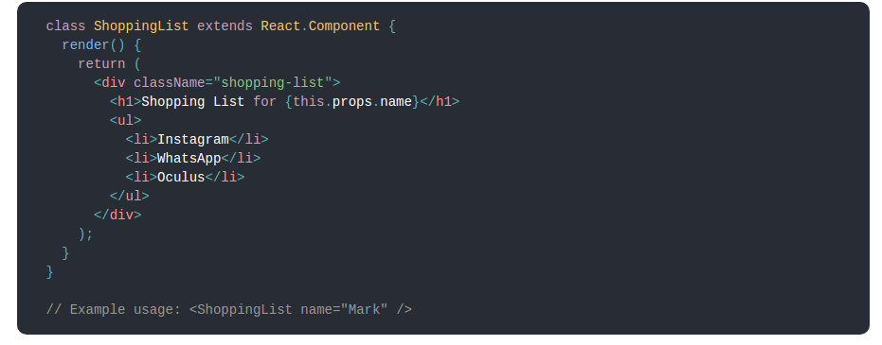
What is Reactjs
React is a declarative, efficient, and flexible JavaScript library for building user interfaces.
ReactJS basically is an open-source JavaScript library which is used for building user interfaces specifically for single page applications.
React also allows us to create reusable UI components.

Slide 2
Why React Js?
Simplicity
Easy to learn (Ironic)
Data Binding
Performance
Testability

Slide 3
JSX
In React, instead of using regular JavaScript for templating, it uses JSX.
class App1 {
render(){
return <Greeting firstName="Ben" lastName="Hector" />;
}
}
const App = () => {
return (
<div>
<Button kind="primary" onClick={() => console.log("clicked!")}>
Hello World!
</Button>
</div>
);
};

Slide 4
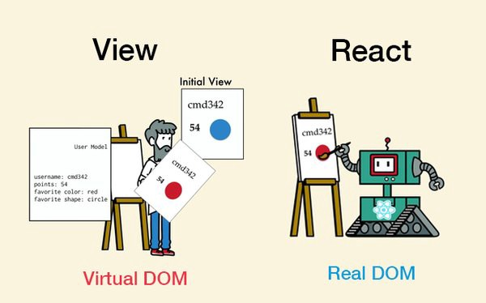
Virtual DOM
React creates an in-memory data structure cache which computes the changes made and then updates the browser.
React library only render components which actually change.

Slide 5
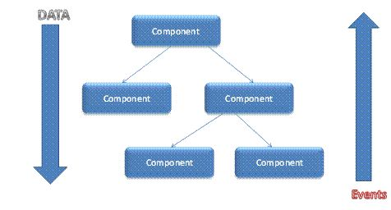
Single-Way data flow
Component cannot directly modify any properties but can pass a call back function with help of which we can do modifications.

Slide 6
React life cycle
Methods prefixed with will are called right before something happens.
Methods prefixed with did are called right after something happens.

Slide 7
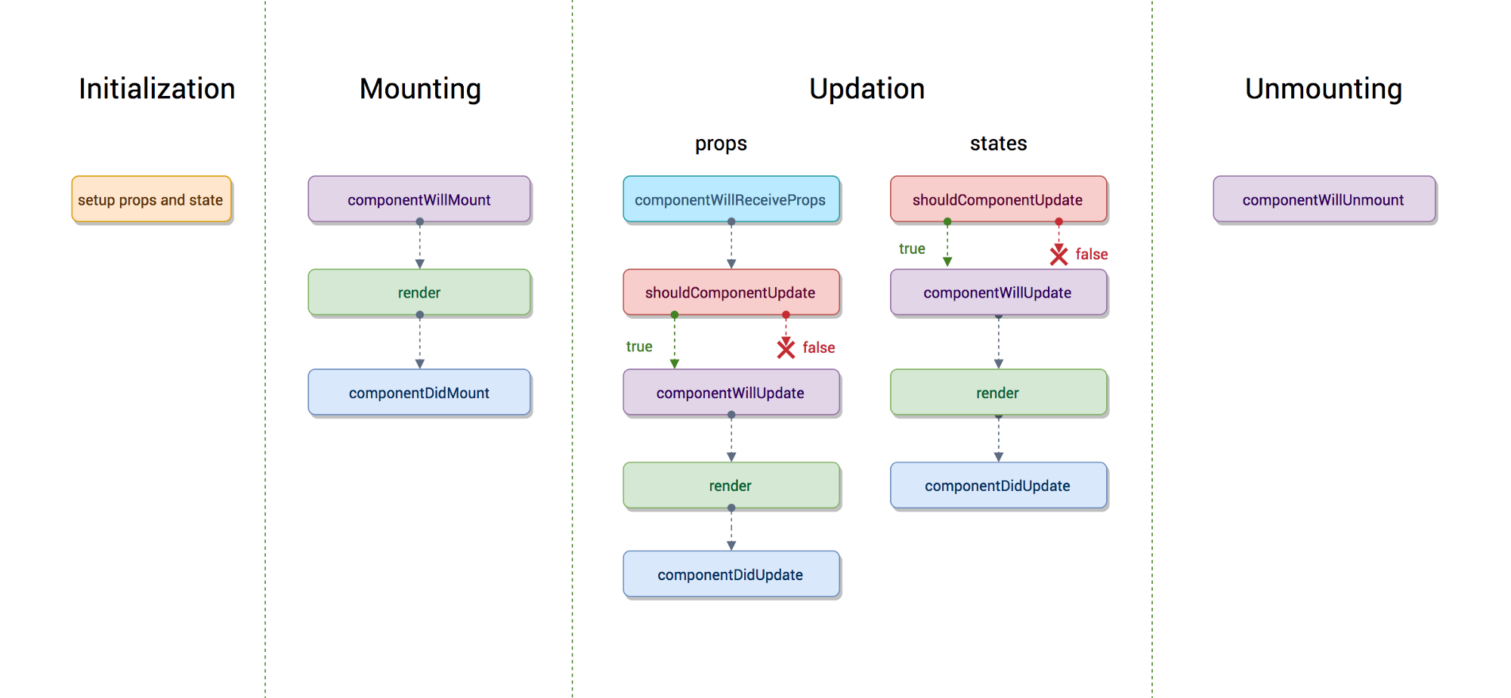
React life cycle

Slide 8
Mounting
These methods are called when an instance of a component is being created and inserted into the DOM:
constructor()
componentWillMount()
render()
componentDidMount()

Slide 9
componentDidMount()
componentDidMount() is invoked immediately after a component is mounted.
This is a good place to instantiate the network request from a remote endpoint.
Calling setState() in this method will trigger an extra rendering, but it will happen before the browser updates the screen.

Slide 10
Updating
An update can be caused by changes to props or state. These methods are called when a component is being re-rendered:
componentWillReceiveProps()
shouldComponentUpdate()
componentWillUpdate()
render()
componentDidUpdate()

Slide 11
shouldComponentUpdate()
Use shouldComponentUpdate() to let React know if a component’s output is not affected by the current change in state or props.
shouldComponentUpdate() is invoked before rendering when new props or state are being received.
Defaults to true.
This method is not called for the initial render or when forceUpdate() is used.

Slide 12
Unmounting
This method is called when a component is being removed from the DOM:
componentWillUnmount()

Slide 13
Error Handling
This method is called when there is an error during rendering, in a lifecycle method, or in the constructor of any child component.
componentDidCatch()

Slide 14
componentDidCatch()
Error boundaries are React components that catch JavaScript errors anywhere in their child component tree, log those errors, and display a fallback UI instead of the component tree that crashed.
Error boundaries catch errors during rendering, in lifecycle methods, and in constructors of the whole tree below them.

Slide 15
Some methods and properties
Instance Properties
props
State
Each component also provides some other APIs:
setState()
ForceUpdate()
Class Properties
DefaultProps
displayName

Slide 16
DefaultProps
If props.color is not provided, it will be set by default to 'blue'
If props.color is set to null, it will remain null
class CustomButton extends React.Component {
// ...
}
CustomButton.defaultProps = {
color: 'blue'
};

Slide 17
props
this.props contains the props that were defined by the caller of this component.
In particular, this.props.children is a special prop, typically defined by the child tags in the JSX expression rather than in the tag itself.

Slide 18
state
The state contains data specific to this component that may change over time. The state is user-defined, and it should be a plain JavaScript object.
If you don’t use it in render(), it shouldn’t be in the state. For example, you can put timer IDs directly on the instance.
Never mutate this.state directly, as calling setState() afterwards may replace the mutation you made. Treat this.state as if it were immutable.

Slide 19
setState()
setState() enqueues changes to the component state and tells React that this component and its children need to be re-rendered with the updated state.
Think of setState() as a request rather than an immediate command to update the component.
React does not guarantee that the state changes are applied immediately.
setState() will always lead to a re-render unless shouldComponentUpdate() returns false.
this.setState((prevState, props) => {
return {counter: prevState.counter + props.step};
});

Slide 20
React Component Constructor
The constructor for a React component is called before it is mounted.
The constructor is the right place to initialize state.
Just assign an object to this.state; don’t try to call setState() from the constructor.
The constructor is also often used to bind event handlers to the class instance.
constructor(props) {
super(props);
this.state = {
color: props.initialColor
};
}

Slide 21

Material UI Components

Slide 22
First React App
https://github.com/burakburuk/javascript-boilerplate

Slide 23
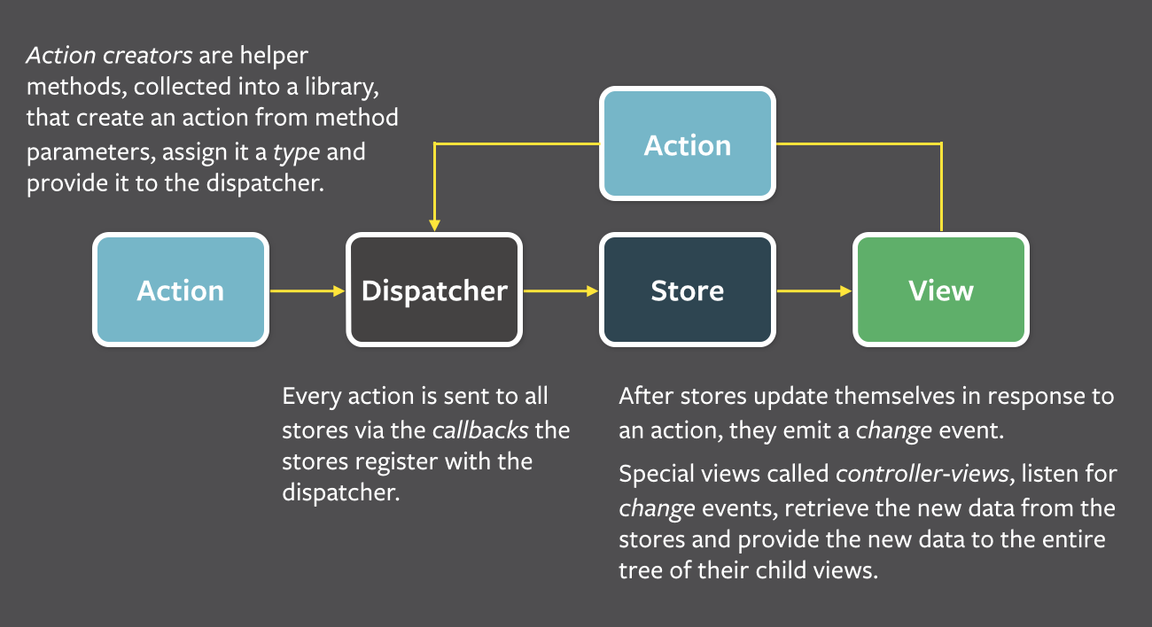
Flux

Slide 24
Redux
Redux has no relation to React.
You can write Redux apps with React, Angular, Ember, jQuery, or vanilla JavaScript.

Slide 25
References
https://webapplog.com/es6/
https://derickbailey.com/2017/06/06/3-features-of-es7-and-beyond-that-you-should-be-using-now/
https://www.npmjs.com/package/axios
https://www.w3schools.com/
https://caniuse.com/#search=es6
https://nodejs.org/en/
https://developer.mozilla.org/en-US/docs/Web/JavaScript/Reference/Classes
https://scotch.io/tutorials/setup-a-react-environment-using-webpack-and-babel
https://github.com/mui-org/material-ui

Slide 26
References
https://reactjs.org/tutorial/tutorial.html
https://github.com/burakburuk/javascript-boilerplate
http://www.material-ui.com/#/
https://redux.js.org/basics/usage-with-react

